Slide 1
Return Oriented Programming
Return oriented programming is a different way to control the flow of EIP in a program
Motivation:
Write or Execute: as a result of overflows, the first prevention technique is to make:
Executable memory segments read-only
Writeable memory segments Non-Executable.
Most slides in this presentation were taken as is from:
Return-oriented Programming: Exploitation without Code Injection
By Erik Buchanan, Ryan Roemer, Stefan Savage, Hovav Shacham from the University of California, San Diego
http://cseweb.ucsd.edu/~hovav/dist/blackhat08.pdf

Slide 2
Getting started
Need control of memory around %esp
Rewrite stack:
Buffer overflow on stack
Format string vuln to rewrite stack contents
Move stack:
Overwrite saved frame pointer on stack; on leave/ret, move %esp to area under attacker control
Overflow function pointer to a register spring for %esp:
set or modify %esp from an attacker-controlled register
then return

Slide 3
Schematic: return to libc
Control hijacking without executing code
stack
libc.so
args
ret-addr
exec()
sfp
printf()
local buf
“/bin/sh”
Notes:
NX wasted effort?
Return to libc is the simplest ROP

Slide 4
Returning to Code Chunks (aka Gadgets)
Instead of working with small “opcodes” and %eip, we now use larger chunks of code and %esp
All the “larger chunks” do multiple register manipulations, and we must consider the effect of all of them.
Not everything we want is possible directly, so we have to be creative and work around the problem.
All chunks end with 0xc3 (RET)
We are effectively using a new ‘language’ to code.
Notes:
Chunk has another, more common name, gadget.

Slide 5
Chunk guidelines
All chunk ends with 0xc3
Chunks should be as minimal as possible, containing minimum amount of data
Chunks are better if they appear in more “stable” and common libraries such as: libc. (and can then be reused for different binaries).
Chunks can not contain Junks.
If the CPU can not interpret the junk in the chunk, it will stop the program with illegal instruction exception.
Notes:
New researches show that gadgets can end with jmp

Slide 6
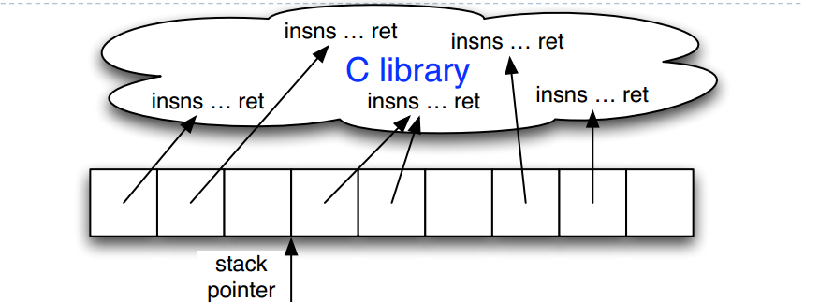
ROP – Machine level
Stack pointer (%esp) determines which instruction
sequence to fetch & execute
Processor doesn’t automatically increment %esp; — but
the “ret” at end of each instruction sequence does
Notes:
Every sequence: insns…ret is a gadget
The question is how to use gadgets to fulfill program logic that can be implemented by normal programming language?

Slide 7
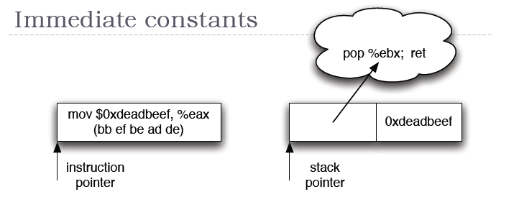
Loading Immediates
Instructions can encode constants
Return-oriented equivalent:
Store on the stack;
Pop into register to use

Slide 8
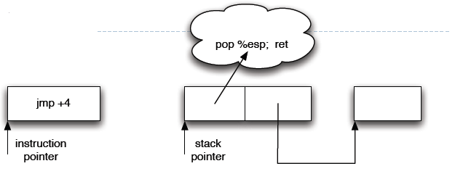
Control flow
Ordinary programming:
(Conditionally) set %eip to new value
Return-oriented equivalent:
(Conditionally) set %esp to new value

Slide 9
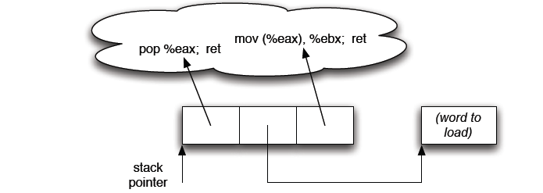
Multiple instruction sequence
Sometimes more than one instruction sequence needed
to encode logical unit
Example: load from memory into register:
Load address of source word into %eax
Load memory at (%eax) into %ebx
Notes:
To implement a logic unit, we need to combine several gadgets.
You can find that a simple instruction may need complicated gadgets combination.

Slide 10
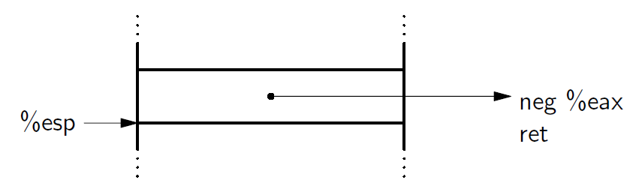
Conditional Jump #0
Negative causes the carry flag to be turn on.
Carry flag can be used in conjunction with ADC.

Slide 11
Conditional Jump #1
ADDR TO: XOR EAX,EAX ; RET
ADDR TO: POP ECX ; RET
DWORD 0
ADDR TO: ADC CL, AL ; RET
ADDR TO: ROL ECX, 1; RET
ADDR TO: ROL ECX, 1; RET
ADDR TO: XCHG EAX, ECX ; RET
ADDR TO: ADD ESP, EAX ; RET.
ADDR TO: POP ESP ; RET # Go somewhere else.
ADDR TO: EXIT
Notes:
ADC adds cl, al and cf
In this example, the result of adc is 1 or 0 depending on CF
The gadget with red color is critical because it calculates the target address depending on CF.
The two ROLs are used to calculate ESP_delta which is the target when CF is true.

Slide 12
Gadget summary
We can write complex shellcode by returning to relevant gadgets.
All gadgets end with ret. (0xc3)
Gadgets can not contain junk (everything must be interpretable)
“JMP” is analogous to finding code that modifies the ESP.
We don’t have to maintain the original alignment of code (on x86).
Example:
MOV EAX, 0x5DC3
This is interpreted into: B8 5D C3
However,
POP EBP
RETN
This is interpreted into:
5D C3
To have we everything flowing correctly and make sure we are aware of where ESP and EIP are pointing to at all times.
Notes:
ROP has been proved Turing complete, indicating we can use ROP do what we can do by C.

